Slide 1
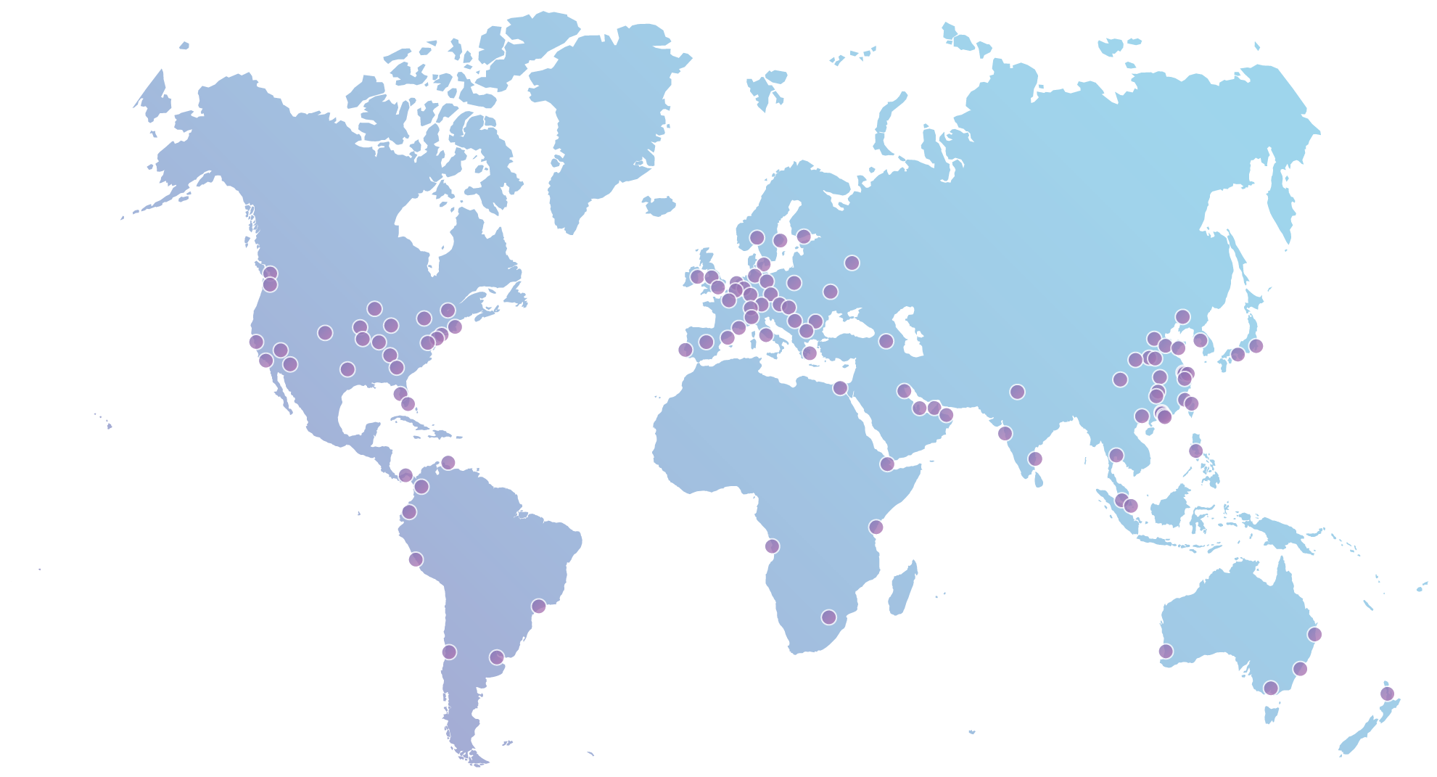
What is Cloudflare?
10MM
Requests/second
10%
Internet requests everyday
117+
Data centers globally
2.5B
6M+
Monthly unique visitors
websites, apps & APIs in 150 countries
Notes:
A quick shout-out to our sponsor today: Cloudflare.
Cloudflare runs 10% of the Internet, providing performance and security to millions of websites. Over 6 million websites, API’s, and apps put Cloudflare in front of their servers to speed up performance, mitigate DDoS attacks, and improve web security.

Slide 2











What is Cloudflare?
Visitors
Visitors
Crawlers & bots
Crawlers & bots
Your website
Your website
Attackers
Attackers
Cloudflare Protected
Notes:
How does Cloudflare work?
Cloudflare sits between your web server (origin server) and the rest of the Internet, serving your content cached from 117+ data centers all over the world. Because of where we sit, we can also inject JS, HTML, and CSS directly into web content, which enables the Cloudflare Apps platform.

Slide 3
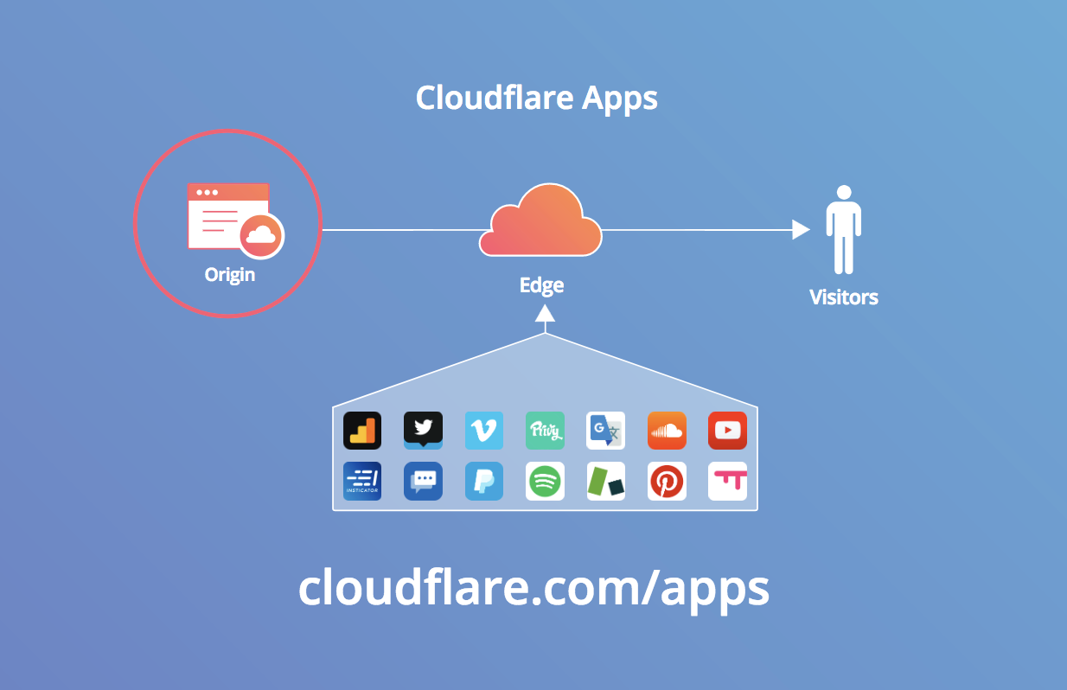
Notes:
As a developer, you can build _apps_ which can be installed by the the millions of sites which rely on Cloudflare. You can even sell your apps; they can make you money _every month_. Visit cloudflare.com/apps to watch how you can build and deploy an app in less than 3 minutes.
Bonus:
App developers can collect up to 100K in Google Cloud Platform credits: https://blog.cloudflare.com/cloudflare-and-google-offer-app-developers-100k/

